Slide 1
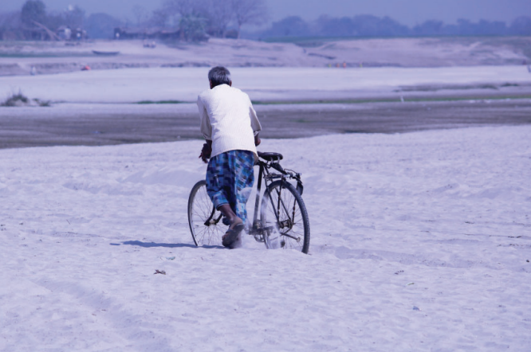
Notes:
Social life on and of sediments

Slide 2
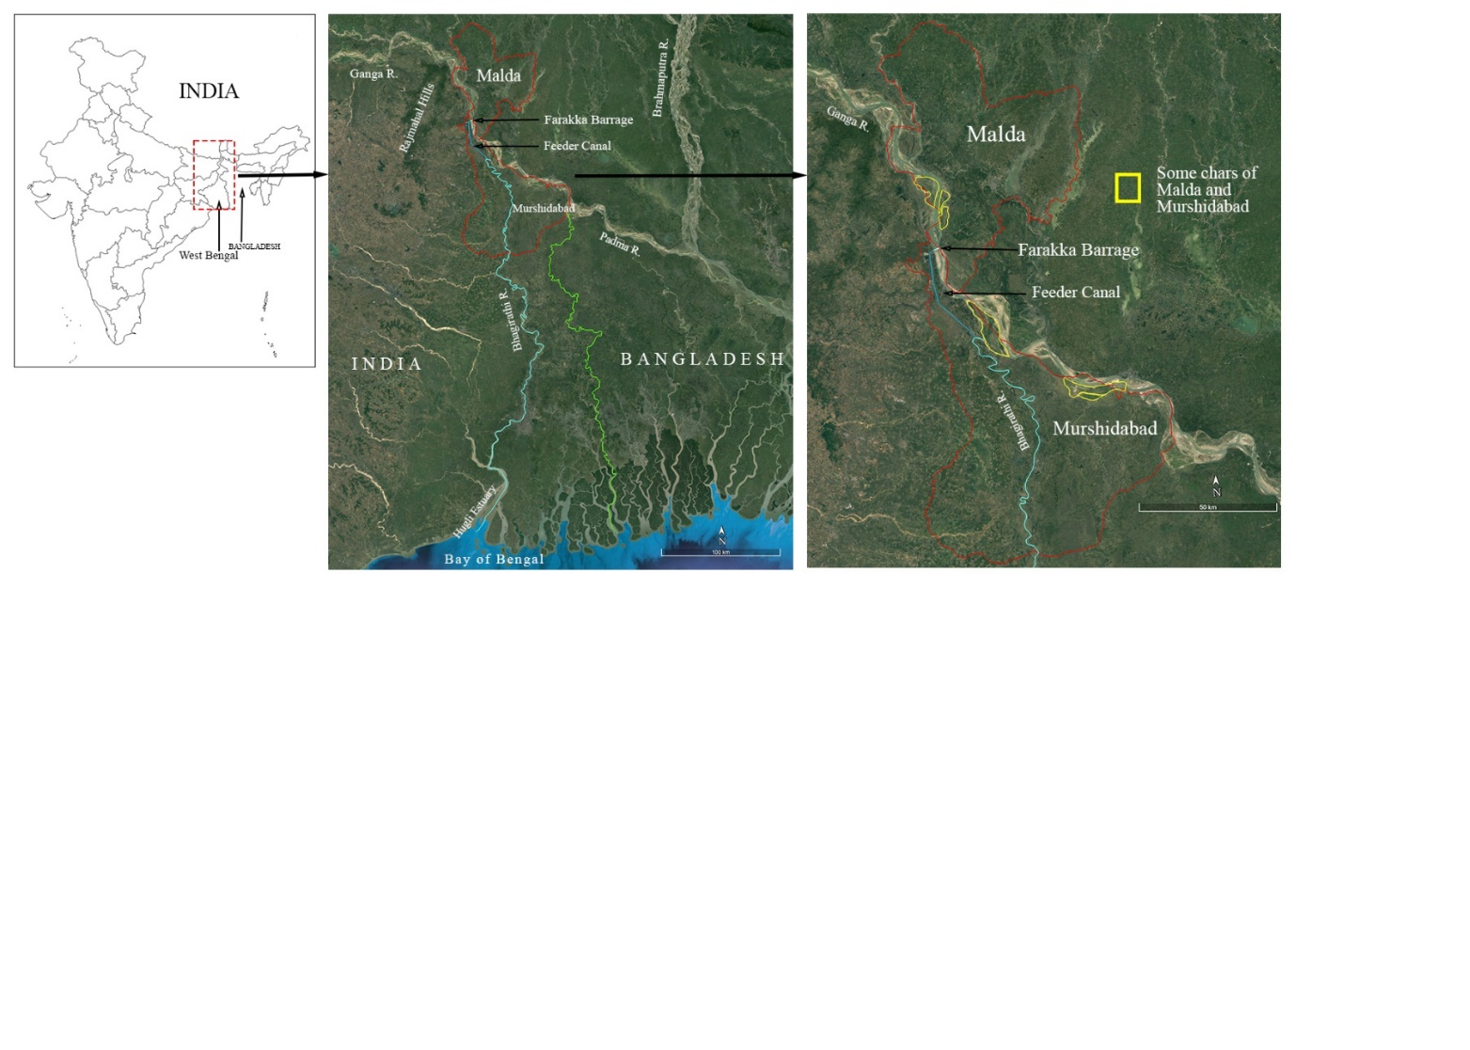

Slide 3
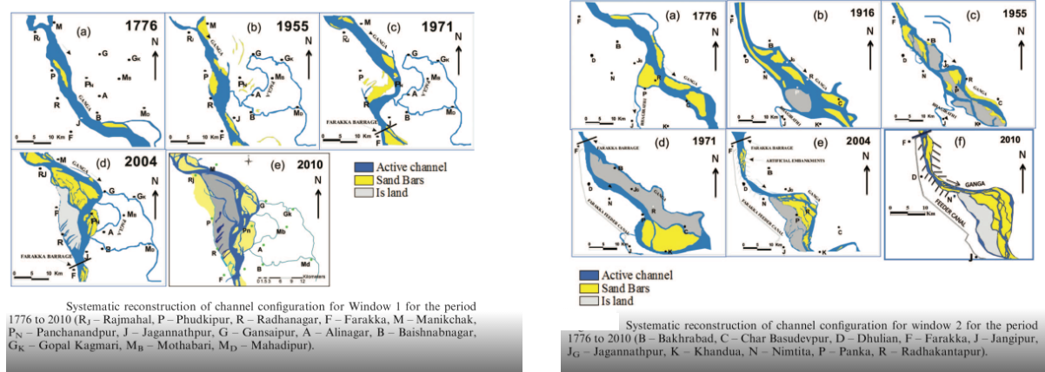

Slide 4
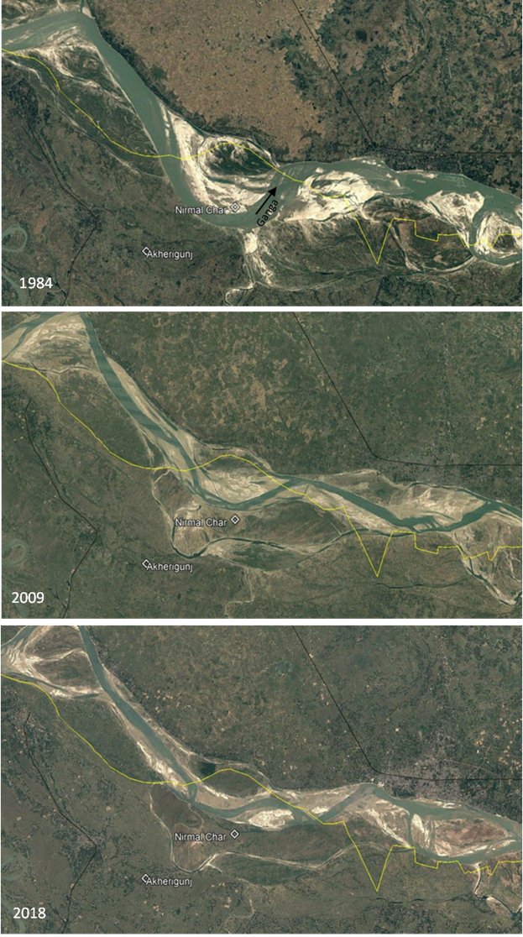
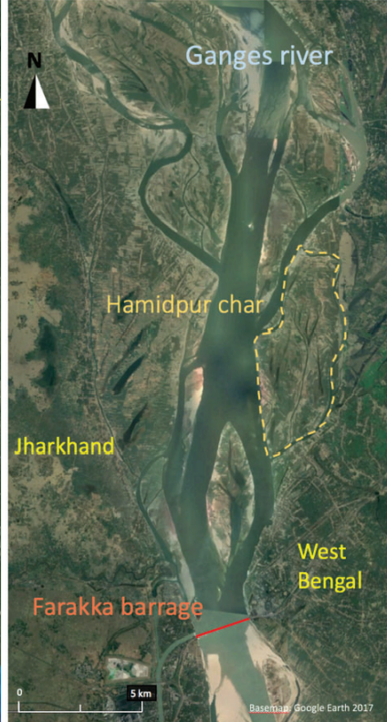
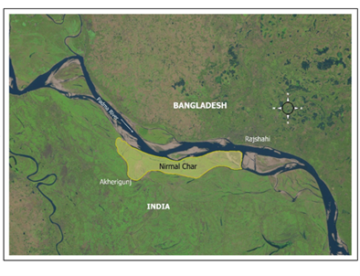

Slide 5
A three-hour long journey through the River Ganga during the summer of 2011 was tiring. As a team from Kolkata, we were involved in an IUCN project in documenting ecosystem services in chars or riverine islands of Bengal. When we spotted the Hamidpur Char from our boat, it appeared like a green-brown patch of solid mass, bifurcating the river into interlacing channels. The extreme heat and dehydration could not bother us for long; the gentle breeze during the evening was pleasant. The villagers embraced us spontaneously and we were ready to weave information from rounds of (more formal) focus group discussions and informal exchanges along transect walks or idle sitting-chatting hours during the afternoon for the next three days.
‘When the massive flood of 1971 eroded part of the Hamidpur Village and we lost our homes, land and everything, we had no other option but to migrate and settle on the newly formed Hamidpur Char that emerged in the middle of the river. After some years, when the char was swallowed by the river current, we migrated again and settled five kilometers north of the Hamidpur Char and these migrations are now an integral part of our lives and livelihoods’ (Extracted from field diary of Mukherjee [2011]).
I remained utterly confused during a long interview with an elderly villager, accompanied by other elderly members of the village and children. Even after repeated and arduous attempts, I failed to figure out the geographical-locational attributes of Hamidpur. I had no clue why the old man kept on referring to virtually every patch of land – both on the mainland lost to erosion and newly formed and dissolved lands in the middle of the river – as Hamidpur. After detailed investigations and probing, I could apprehend and discern that Hamidpur is not a bounded place – it is a shifting habitat, yet an unchanging cultural space. The char is a cognitively constituted cultural space, forging collective identities among choruas (char inhabitants) who keep naming their shifting habitat Hamidpur. Hamidpur symbolizes the continuity of chorua cultural identity, transplanted-obliterated-resurrected in repetitive cycles along river island archipelagos dotting the upper stretch of the Lower Ganga Basin.
Mukherjee, J., Lahiri-Dutt, K. and Ghosh, R. 2023. Beyond (un)stable: chars as dynamic destabilisers of problematic binaries. Social Anthropologie.

Slide 6
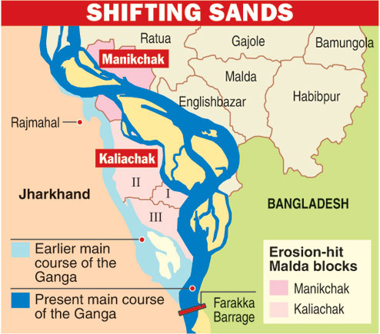
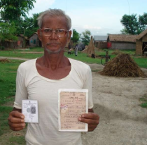

Slide 7
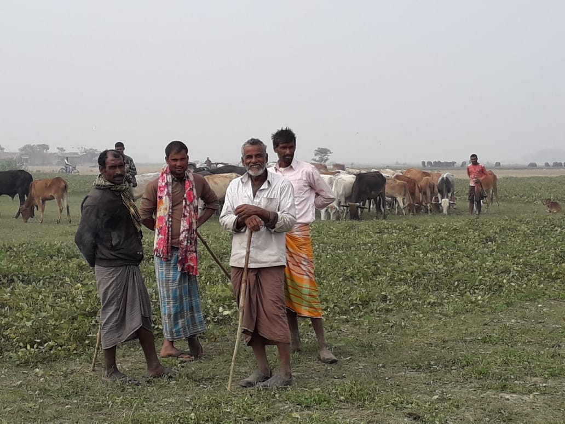
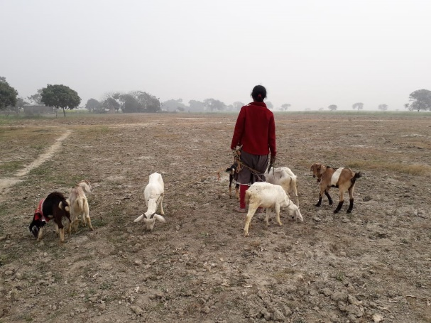
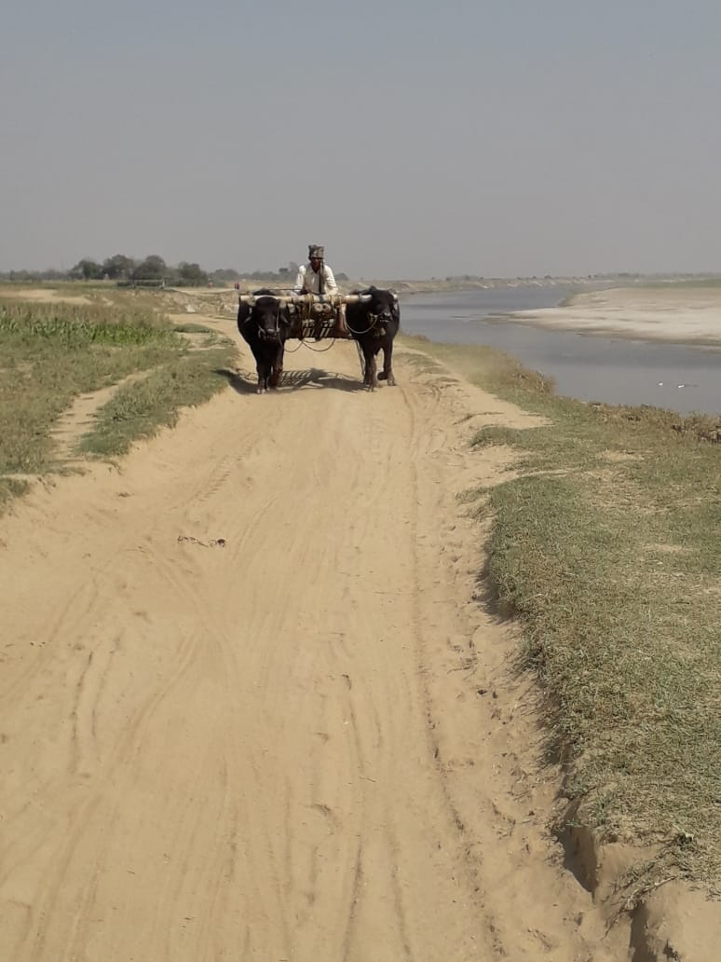

Slide 8
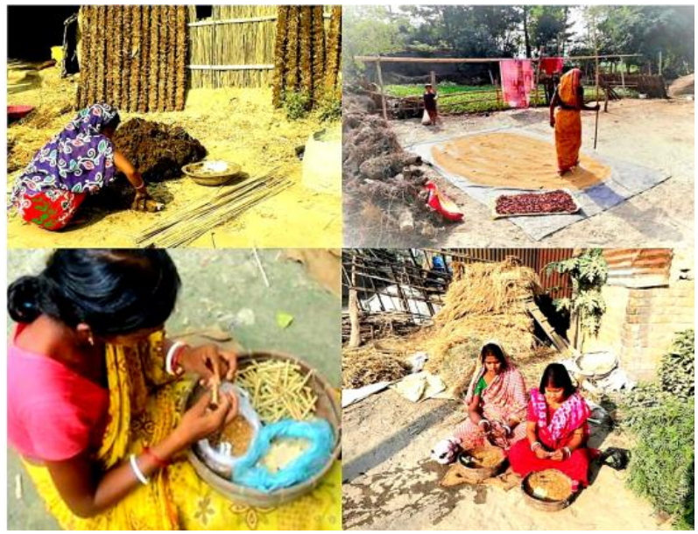

Slide 9
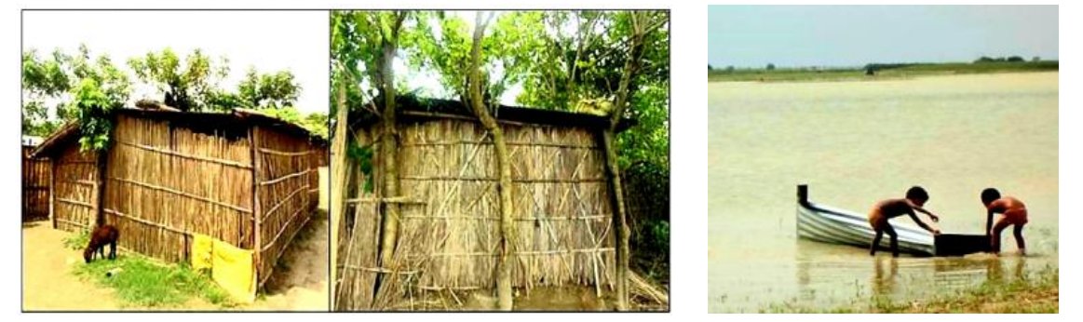

Slide 10

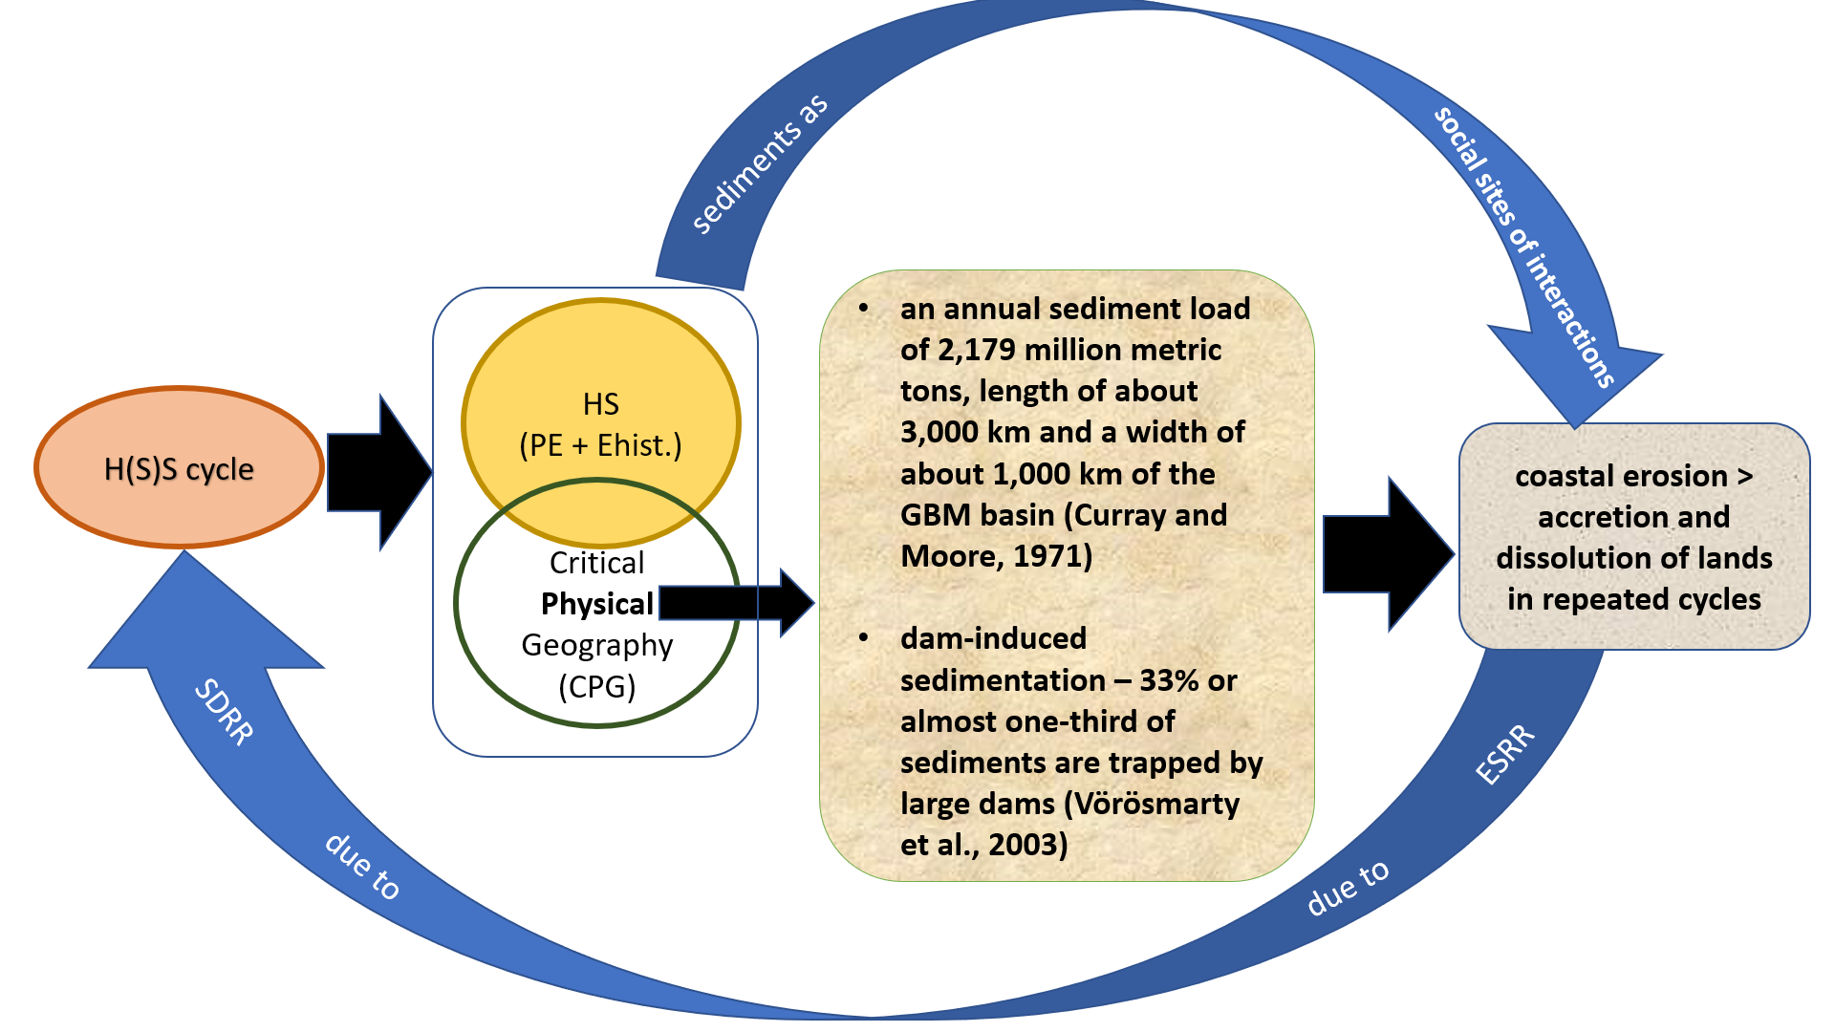
SDRR implies
Settlement
Displacement
Resettlement
Re-displacement
fluvio-morphological processes
technological apparatuses
mediated social arrangements
ESRR implies
Emergence
Submergence
Re-emergence
Re-submergence
not (only) emblems of uncertainties but also zones of possibilities, guaranteeing livelihoods provisions for choruas who continue experimenting with contingent adjustments and frugal innovative practices to deal with environmental risks in chars.

